Slide 1

Introduction to PowerPoint
All the Basics that You Need to Know!

Slide 2

PowerPoint Software
PowerPoint is software that lets you make presentations.
Each PowerPoint presentation is made up of a group of slides.
The abbreviation for PowerPoint is PPT.

Slide 3

How People Use PowerPoint
People use PowerPoint to make slideshow presentations about many topics.
business presentations
school presentations
family events

Slide 4
Business people Use PowerPoint
Businesspeople frequently use PowerPoint to make:
Sales presentations
Employee training presentations

Slide 5

Teachers Use PowerPoint
Teachers use PowerPoint to:
Explain new topics
Give directions

Slide 6
Students Use PowerPoint
Students use PowerPoint to:
Present assignments
Improve writing skills
Improve oral presentation skills

Slide 7
Questions About PowerPoint
What kind of software is PowerPoint?
What do business people use PowerPoint for?
What do students use PowerPoint for?

Slide 8
PowerPoint Software
In this section of the presentation you will learn what a PowerPoint window looks like.

Slide 9
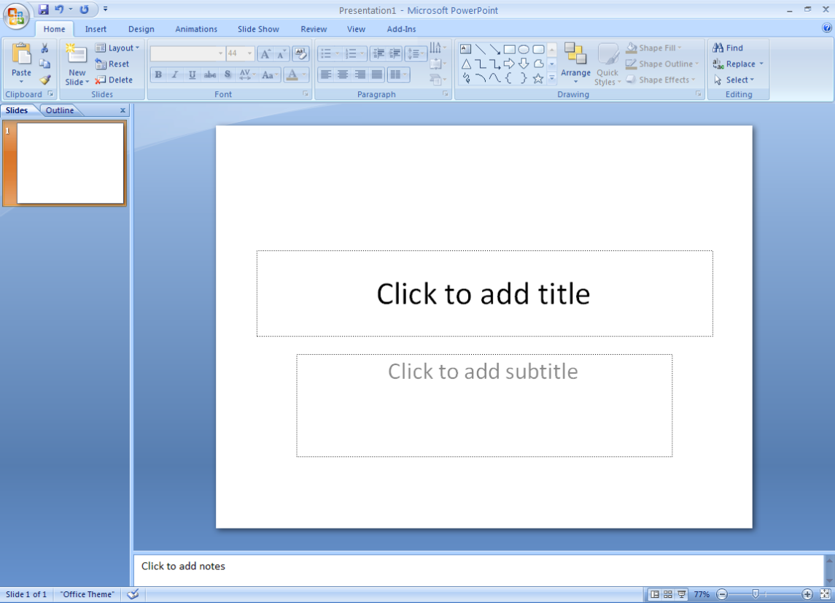
THE POWERPOINT WINDOW
Office button
Title bar
After you start PowerPoint, you see a screen such as the one shown here.
The status bar shows information about the presentation, such as the slide number and theme name.
The content box is where you can type or add pictures.
The Notes Pane is where you can type notes to yourself about what you will say about the slide.
The Slides Tab shows all of the slides in your presentation.
The Outline Tab shows an outline of your presentation.
Ribbon
Outline tab
Slides tab
Content Box
Content Box
Status bar
Notes pane
A presentation is a set of slides or handouts that contains information you want to tell an audience.

Slide 10
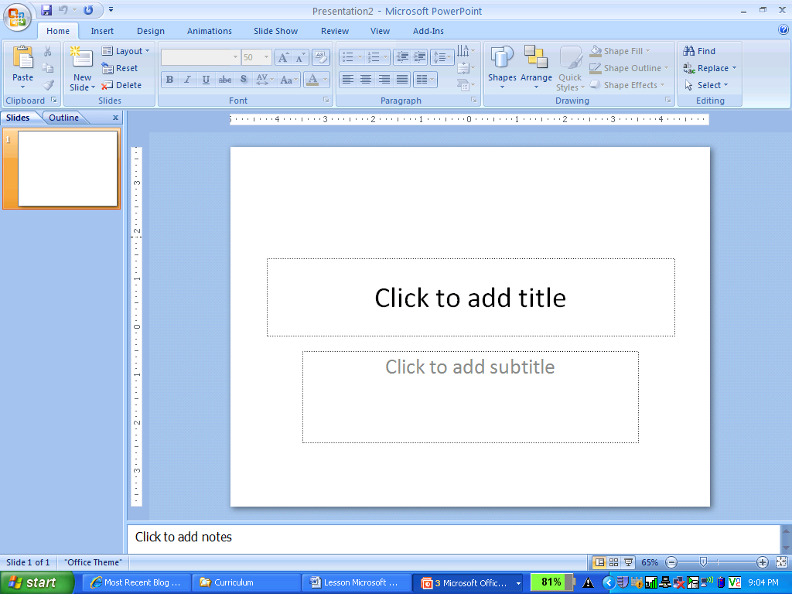
Questions about the PowerPoint Window
Hit the Esc Key on your keyboard to see the PowerPoint Window.
Where is the Slide Pane?
Where is the Status Bar? What does the Status Bar show?
Where is the Ribbon?
Where are the Slides and Outline tabs? Click on each to see what they show.
Hit the Slide Show Button on the Status Bar to go back to the Slide Show

Slide 11
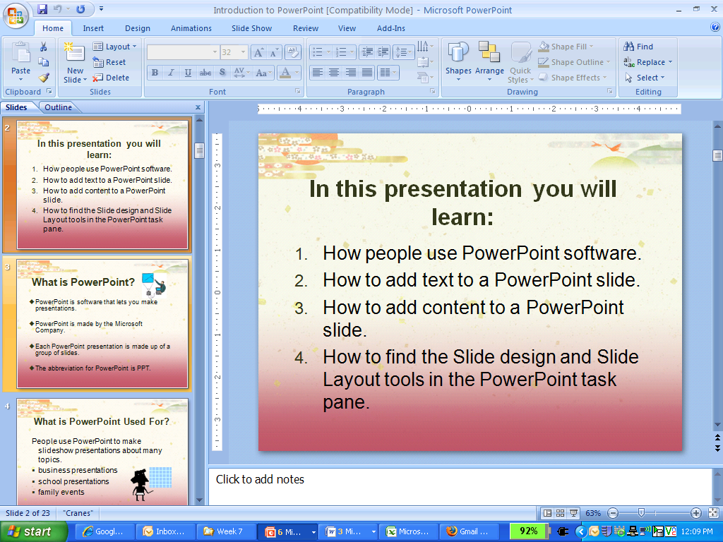
PowerPoint Slides
In this section of the presentation you will learn more about PowerPoint slides.
Slides are what you use to organize your presentation!

Slide 12
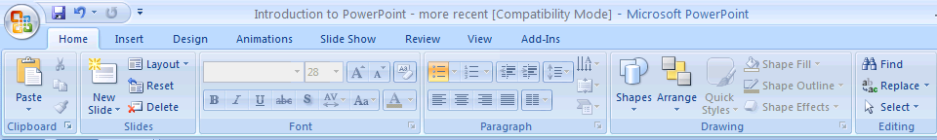
PowerPoint Slide Layout
In PowerPoint you will see some new tools on the Home Tab of the Ribbon:
Layout – You will use this to change the slide layout
New Slide – You will use this to add a new slide.

Slide 13
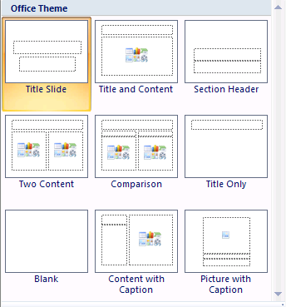
PowerPoint Slide Layout
Slide Layout is the way text, content, or other features are organized on a slide.
Each slide should include a title, text and other items such as Clip Art or pictures.

Slide 14
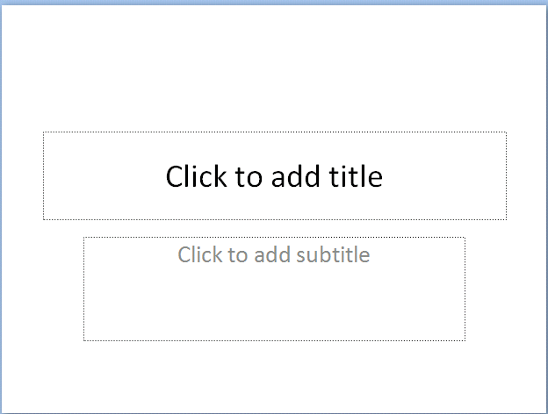
The Title Slide
The first slide you make is the title slide.
This is the first slide in all presentations because it shows the title and the author

Slide 15
Content Layout
All the other slides in your presentation should have a title, text and content.
Content means text, pictures or graphs.

Slide 16
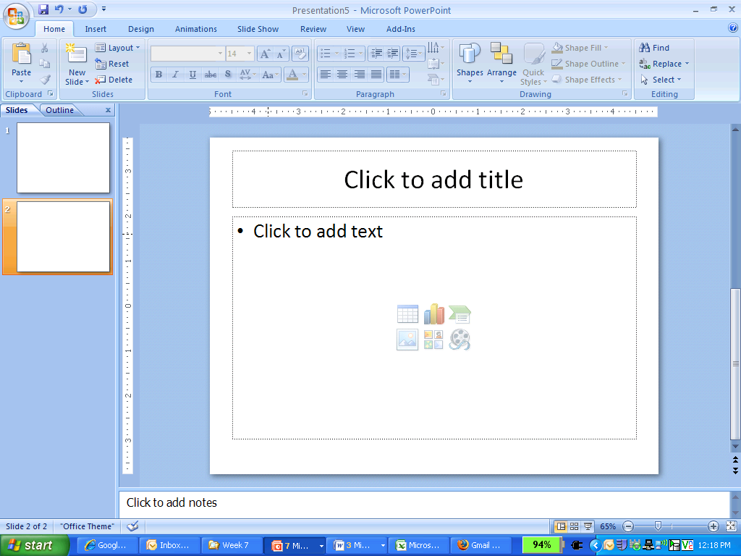
Slide Text
Slide Title
Slide Content
Text are the words and sentences that you type into each slide.
You type the text into the textbox in each slide.
Text can be formatted.

Slide 17
Slide Pictures & Images
You can also add:
Clip Art
Pictures from the Internet
Graphs and charts.
Images make your slides more interesting.

Slide 18
Adding Content to Slides
To add content to a slide click one of the six icons:
Table
Chart
Graphic
Picture
Clip Art
Media

Slide 19
Questions About PowerPoint Slides
What does Slide Layout mean?
What should you type on the first slide in a PowerPoint presentation?
What is the slide title?
What does slide content include?

Slide 20
PowerPoint Slide Design
Now you will learn about Slide Design.
Slide Design is how your slides appear visually with background colors and designs.

Slide 21
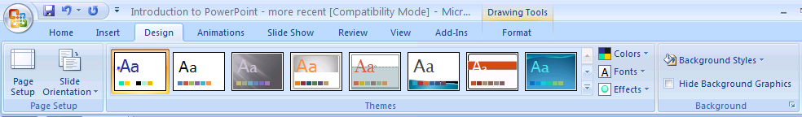
Slide Design
Slide Design:
is located on the Design Tab of the Ribbon.

Slide 22

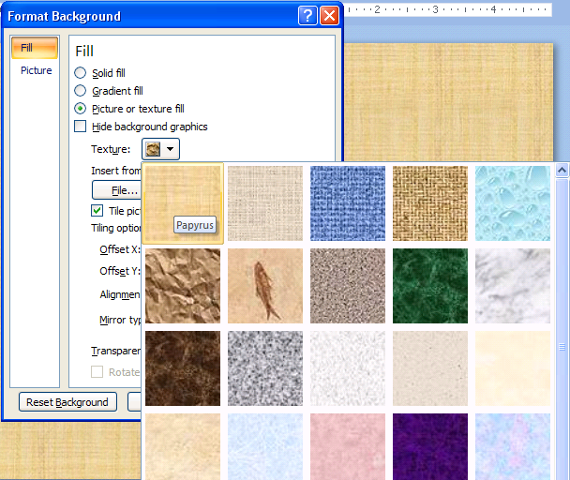
Slide Design
You can use TEXTURES as a background for your slide

Slide 23
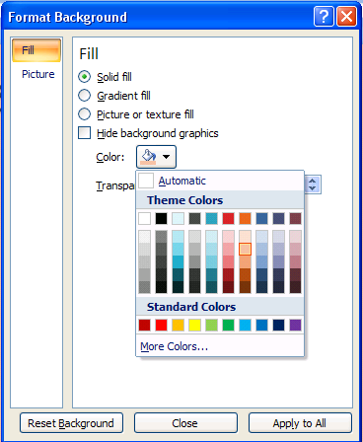
Slide Design
You can use COLORS as a background for your Slide

Slide 24
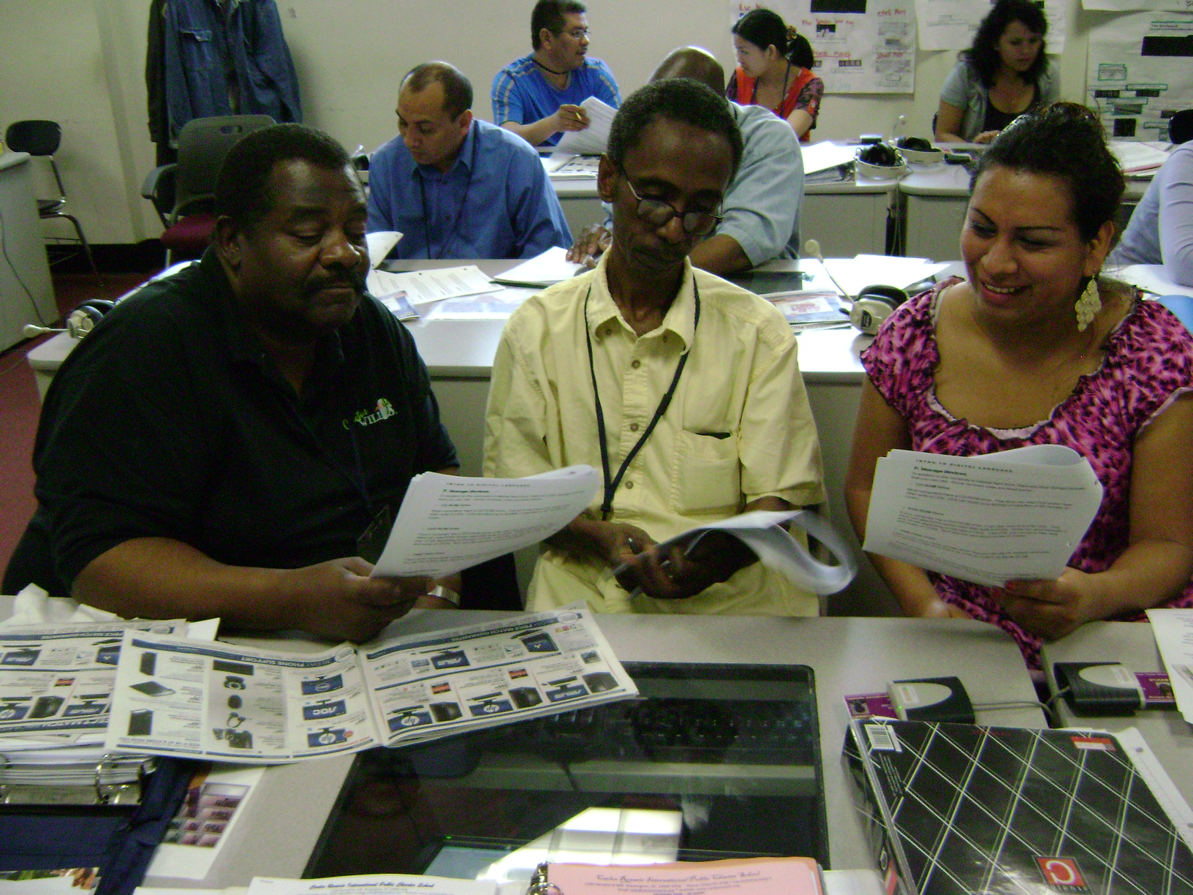
Slide Design
You can use PICTURES as a background for your slide

Slide 25
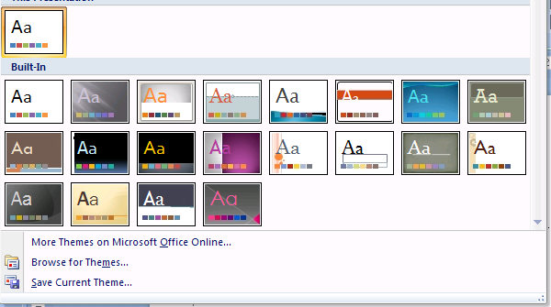
Slide Design
You can also use the Design Gallery

Slide 26
Questions About Slide Design
What is Slide Design?
What can you use as a background for your slides?

Slide 27
Ready to start
Now you are ready to start.
Open the PowerPoint software on your computer.
Look at the parts of PowerPoint.
Try to name some of the parts.
Use the Home Tab on the Ribbon to add New Slides and change Layouts.

